Slide 1
What is a Network?
Network = graph
Informally a graph is a set of nodes joined by a set of lines or arrows.
1
3
1
2
3
2
4
5
6
4
5
6

Slide 2
Graph-based representations
Representing a problem as a graph can provide a different point of view
Representing a problem as a graph can make a problem much simpler
  More accurately, it can provide the appropriate tools for solving the problem

Slide 3
What is network theory?
Network theory provides a set of techniques for analysing graphs
Complex systems network theory provides techniques for analysing structure in a system of interacting agents, represented as a network
Applying network theory to a system means using a graph-theoretic representation

Slide 4
What makes a problem graph-like?
There are two components to a graph
  Nodes and edges
In graph-like problems, these components have natural correspondences to problem elements
  Entities are nodes and interactions between entities are edges
Most complex systems are graph-like

Slide 5
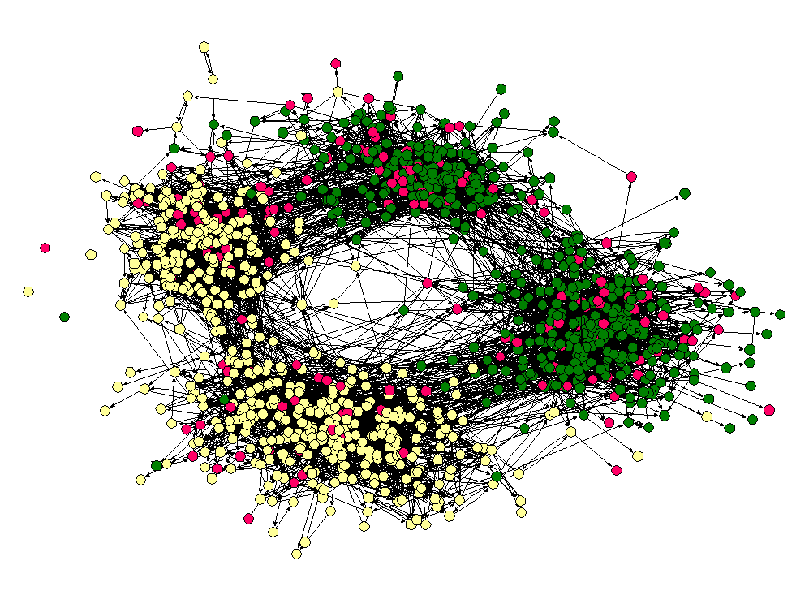
Friendship Network

Slide 6
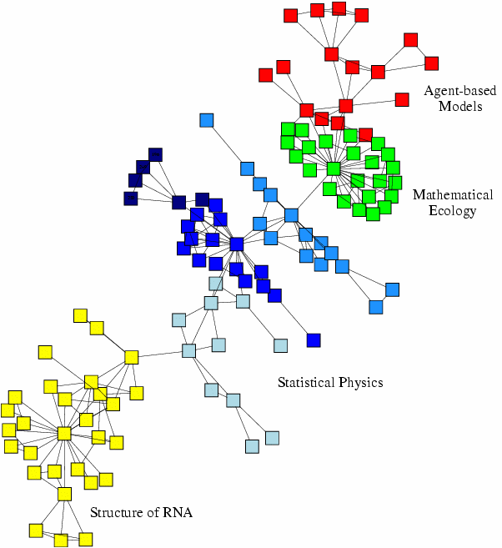
Scientific collaboration network

Slide 7
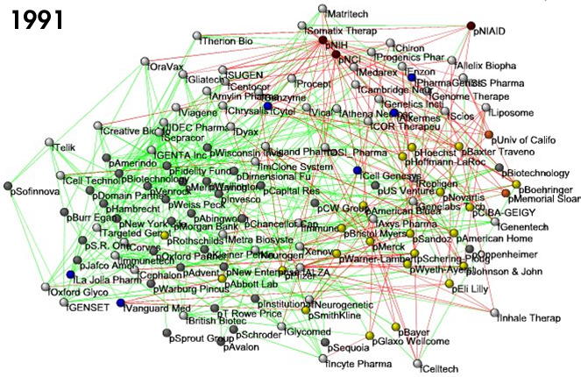
Business ties in US
biotech-industry

Slide 8
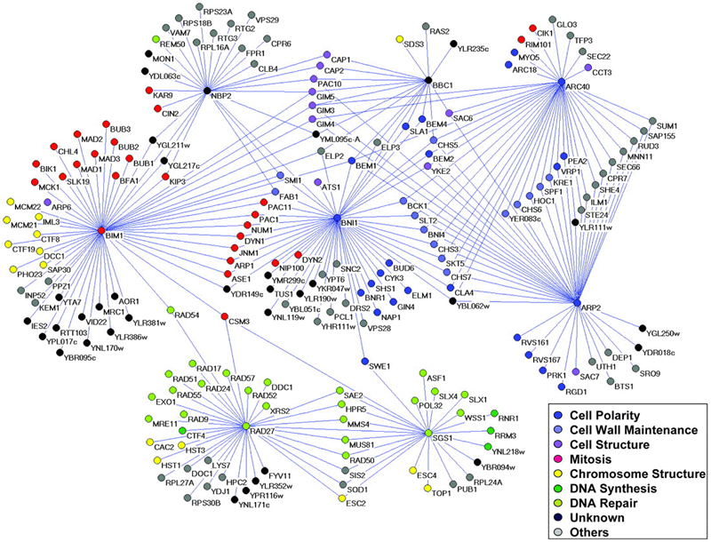
Genetic interaction network

Slide 9
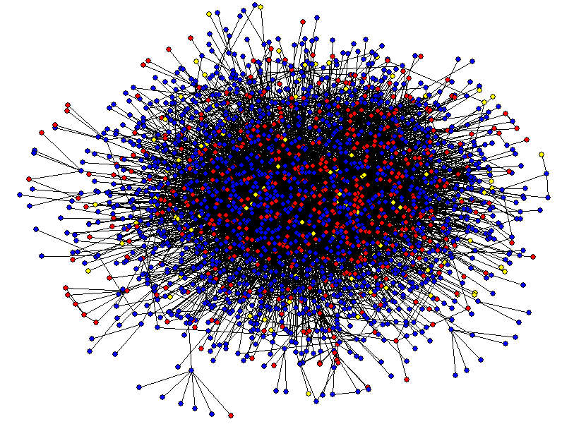
Protein-Protein Interaction Networks

Slide 10
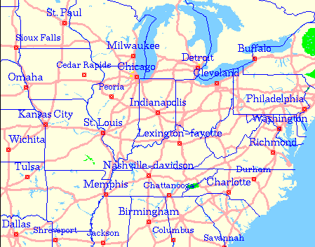
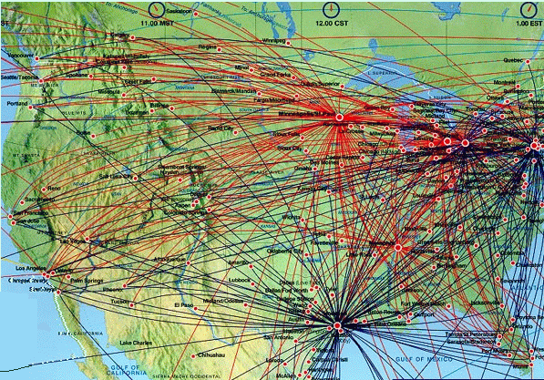
Transportation Networks

Slide 11
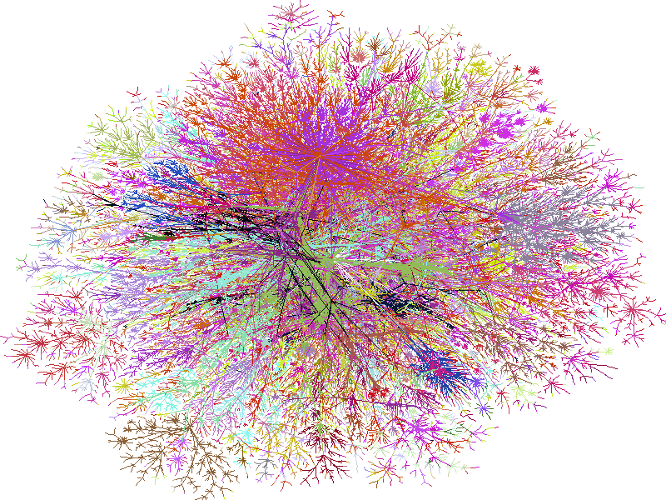
Internet

Slide 12
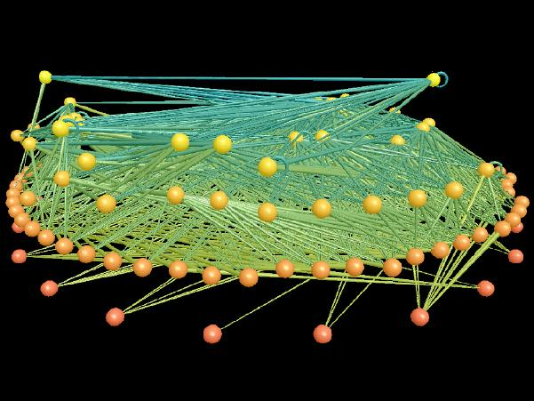
Ecological Networks

Slide 13
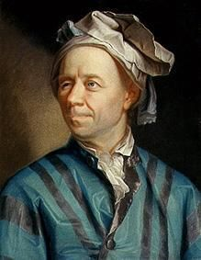
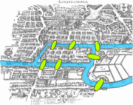
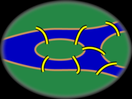
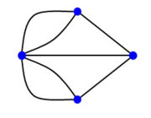
Graph Theory - History
Leonhard Euler's paper on “Seven Bridges of Königsberg” ,
published in 1736.

Slide 14
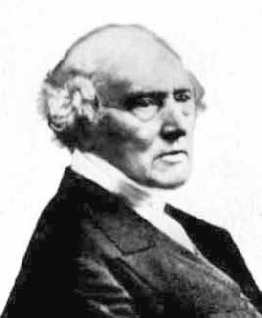
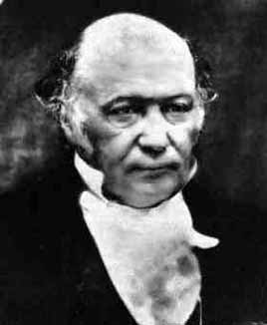
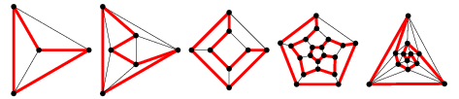
Graph Theory - History
Cycles in Polyhedra
Thomas P. Kirkman William R. Hamilton
Hamiltonian cycles in Platonic graphs

Slide 15
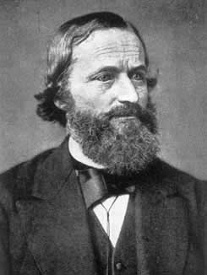
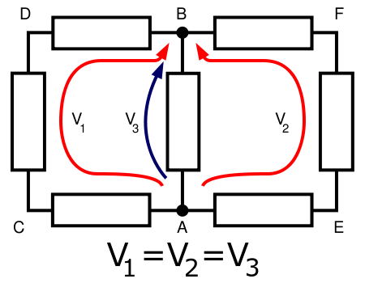
Graph Theory - History
Trees in Electric Circuits
Gustav Kirchhoff

Slide 16
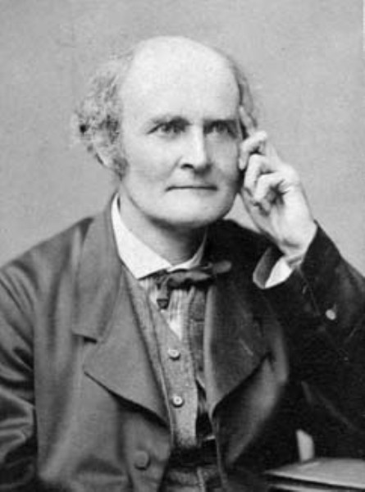
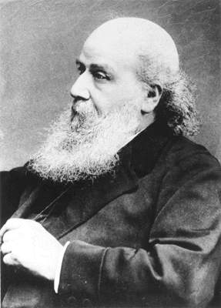
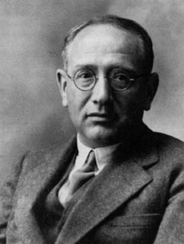
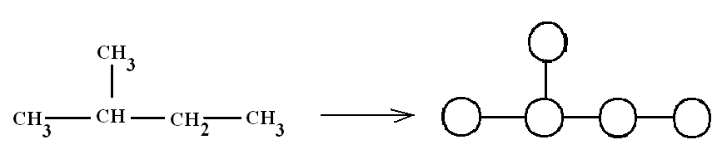
Graph Theory - History
Enumeration of Chemical Isomers –n.b. topological distance a.k.a chemical distance
Arthur Cayley James J. Sylvester George Polya

Slide 17
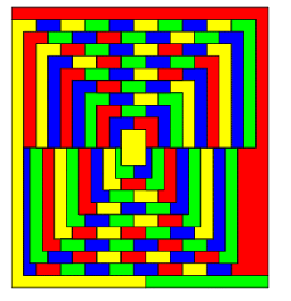
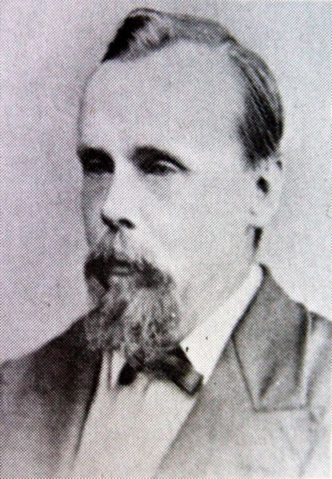
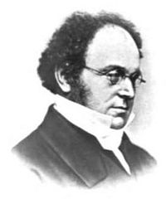
Graph Theory - History
Four Colors of Maps
Francis Guthrie Auguste DeMorgan

Slide 18
Definition: Graph
G is an ordered triple G:=(V, E, f)
  V is a set of nodes, points, or vertices.
  E is a set, whose elements are known as edges or lines.
  f is a function
    maps each element of E
    to an unordered pair of vertices in V.

Slide 19
Definitions
Vertex
  Basic Element
  Drawn as a node or a dot.
  Vertex set of G is usually denoted by V(G), or V
Edge
  A set of two elements
  Drawn as a line connecting two vertices, called end vertices, or endpoints.
  The edge set of G is usually denoted by E(G), or E.

Slide 20
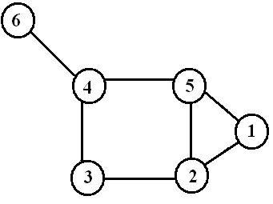
Example
V:={1,2,3,4,5,6}
E:={{1,2},{1,5},{2,3},{2,5},{3,4},{4,5},{4,6}}

Slide 21
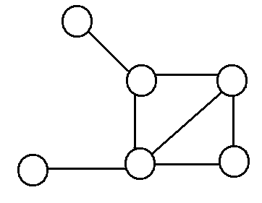
Simple Graphs
Simple graphs are graphs without multiple edges or self-loops.

Slide 22
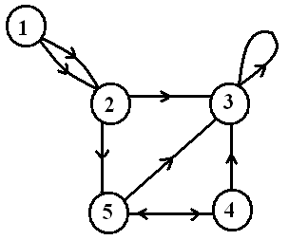
Directed Graph (digraph)
Edges have directions
  An edge is an ordered pair of nodes
loop
multiple arc
arc
node

Slide 23
Weighted graphs
is a graph for which each edge has an associated weight, usually given by a weight function w: E → R.
1.2
2
1
2
3
1
2
3
.2
.5
1.5
5
3
.3
1
4
5
6
4
5
6
.5

Slide 24
Structures and structural metrics
Graph structures are used to isolate interesting or important sections of a graph
Structural metrics provide a measurement of a structural property of a graph
  Global metrics refer to a whole graph
  Local metrics refer to a single node in a graph

Slide 25
Graph structures
Identify interesting sections of a graph
  Interesting because they form a significant domain-specific structure, or because they significantly contribute to graph properties
A subset of the nodes and edges in a graph that possess certain characteristics, or relate to each other in particular ways

Slide 26
Connectivity
a graph is connected if
  you can get from any node to any other by following a sequence of edges OR
  any two nodes are connected by a path.
A directed graph is strongly connected if there is a directed path from any node to any other node.

Slide 27
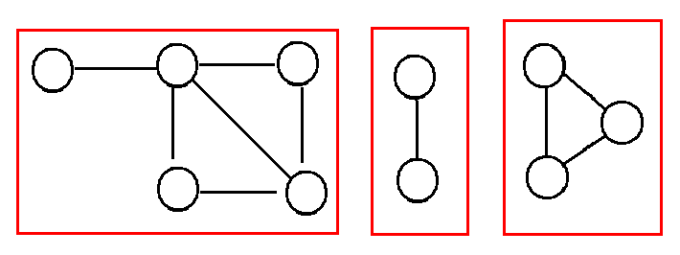
Component
Every disconnected graph can be split up into a number of connected components.

Slide 28
Degree
Number of edges incident on a node
The degree of 5 is 3

Slide 29
Degree (Directed Graphs)
In-degree: Number of edges entering
Out-degree: Number of edges leaving
Degree = indeg + outdeg
outdeg(1)=2
indeg(1)=0
outdeg(2)=2
indeg(2)=2
outdeg(3)=1
indeg(3)=4

Slide 30
Degree: Simple Facts
If G is a graph with m edges, then
Σ deg(v) = 2m = 2 |E |
If G is a digraph then
Σ indeg(v)=Σ outdeg(v) = |E |
Number of Odd degree Nodes is even

Slide 31
Walks
A walk of length k in a graph is a succession of k
(not necessarily different) edges of the form
uv,vw,wx,…,yz.
This walk is denote by uvwx…xz, and is referred to
as a walk between u and z.
A walk is closed is u=z.

Slide 32
Path
A path is a walk in which all the edges and all the nodes are different.
Walks and Paths
1,2,5,2,3,4 1,2,5,2,3,2,1 1,2,3,4,6
walk of length 5 CW of length 6 path of length 4

Slide 33
Cycle
A cycle is a closed walk in which all the edges are different.
1,2,5,1 2,3,4,5,2
3-cycle 4-cycle

Slide 34
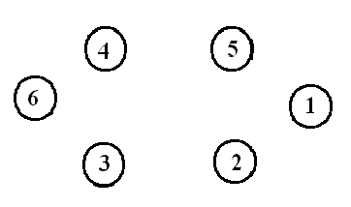
Special Types of Graphs
Empty Graph / Edgeless graph
  No edge
Null graph
  No nodes
  Obviously no edge

Slide 35

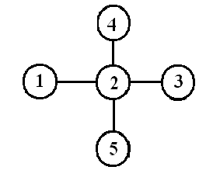
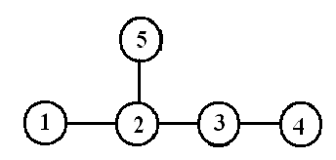
Trees
Connected Acyclic Graph
Two nodes have exactly one path between them c.f. routing, later

Slide 36
Special Trees
Paths
Stars

Slide 37
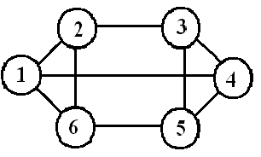

Regular
Connected Graph
All nodes have the same degree

Slide 38
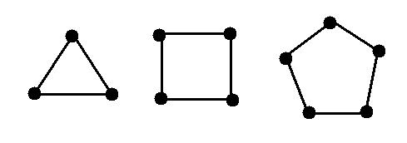
Special Regular Graphs: Cycles
C₃ C₄ C₅

Slide 39
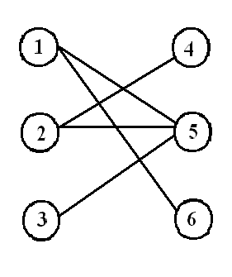
Bipartite graph
V can be partitioned into 2 sets V₁ and V₂
such that (u,v)∈E implies
  either u ∈V₁ and v ∈V₂
  OR v ∈V₁ and u∈V_{2.}
Shows up in coding&modulation algorithms

Slide 40
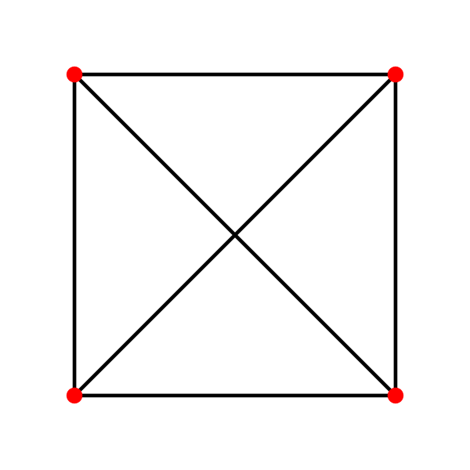

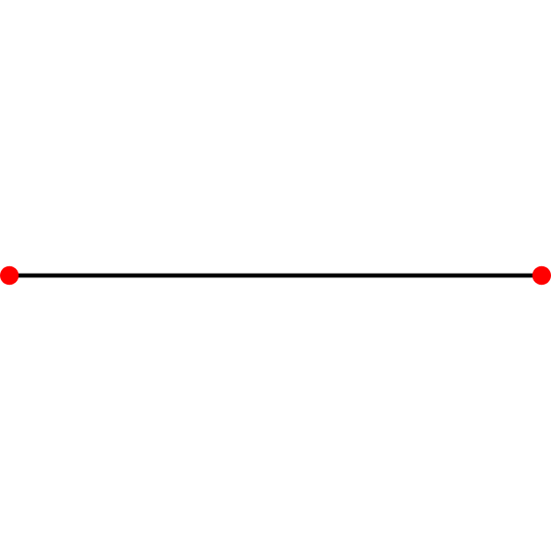
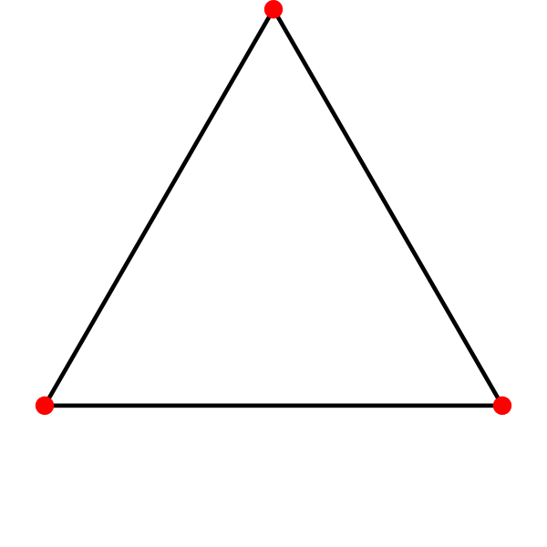
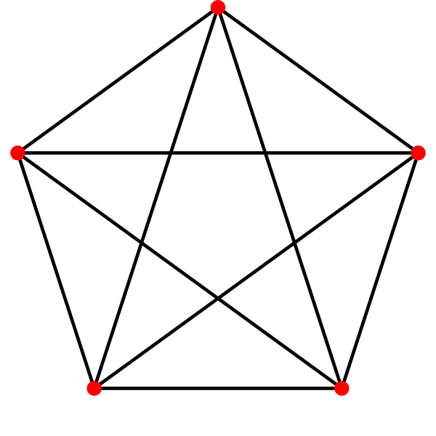
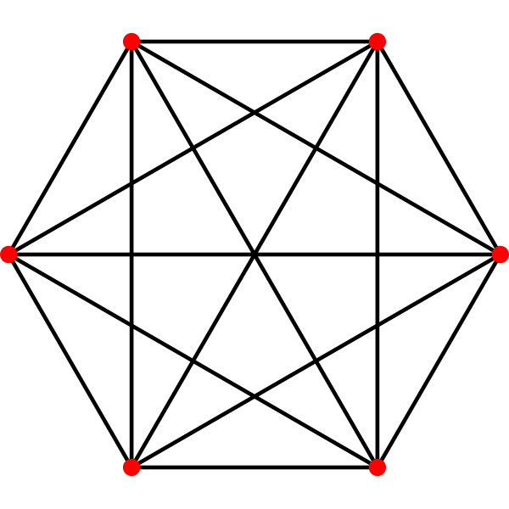
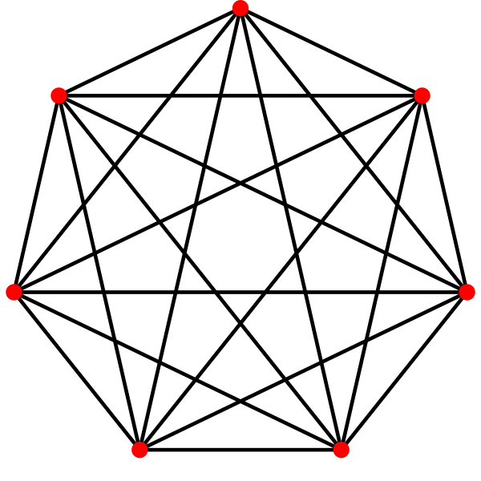
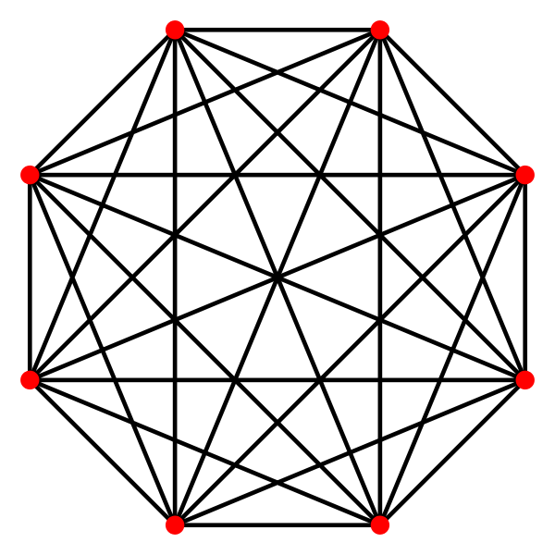
Complete Graph
Every pair of vertices are adjacent
Has n(n-1)/2 edges
See switches&multicore interconnects

Slide 41
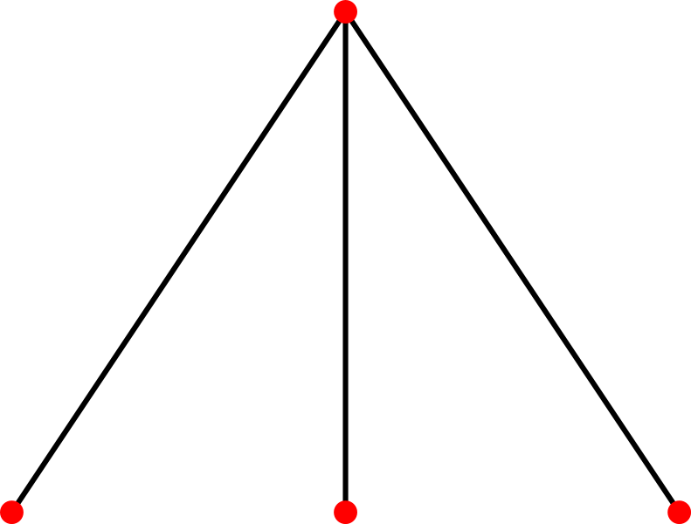
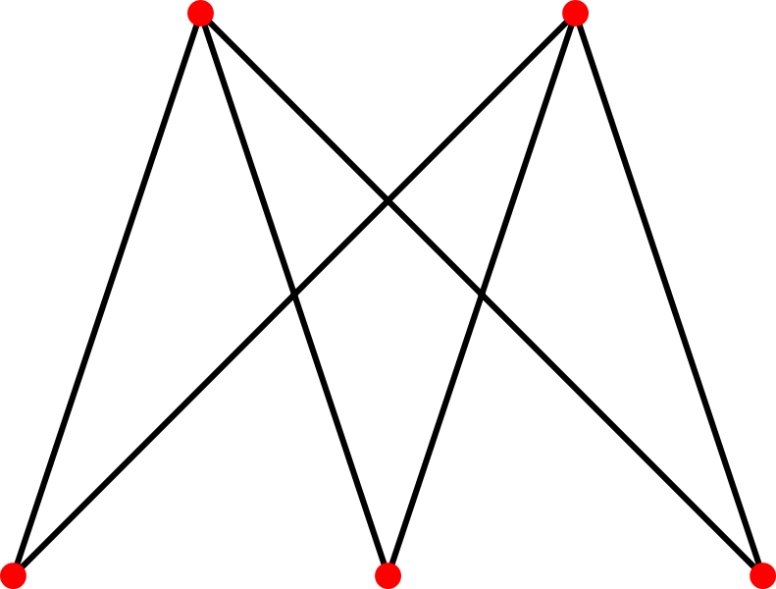
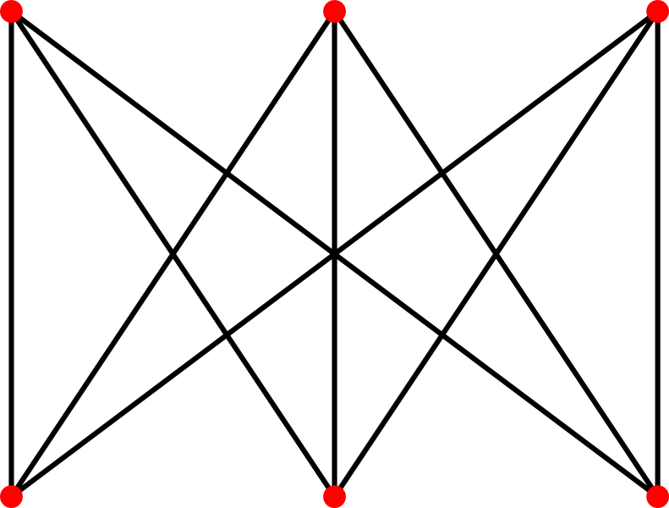
Complete Bipartite Graph
Bipartite Variation of Complete Graph
Every node of one set is connected to every other node on the other set
Stars

Slide 42
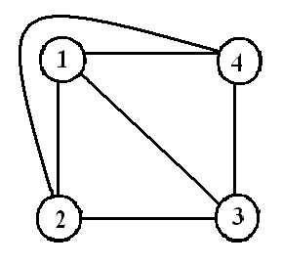
Planar Graphs
Can be drawn on a plane such that no two edges intersect
K₄ is the largest complete graph that is planar

Slide 43
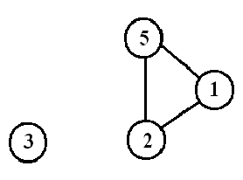
Subgraph
Vertex and edge sets are subsets of those of G
  a supergraph of a graph G is a graph that contains G as a subgraph.

Slide 44
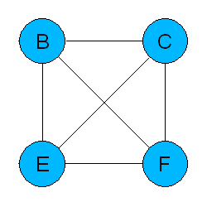
Special Subgraphs: Cliques
A clique is a maximum complete connected subgraph.
A
B
C
D
E
F
G
H
I

Slide 45
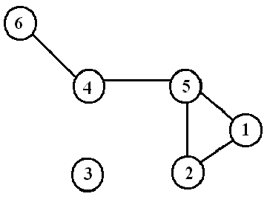
Spanning subgraph
Subgraph H has the same vertex set as G.
  Possibly not all the edges
  “H spans G”.

Slide 46
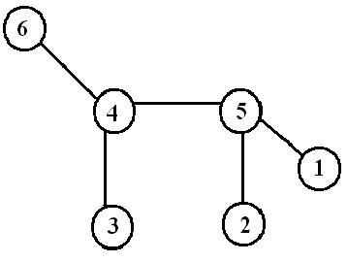
Spanning tree
Let G be a connected graph. Then a spanning tree in G is a subgraph of G that includes every node and is also a tree. Routing (esp bridges)

Slide 47
Isomorphism
Bijection, i.e., a one-to-one mapping:
  f : V(G) -> V(H)
u and v from G are adjacent if and only if f(u) and f(v) are adjacent in H.
If an isomorphism can be constructed between two graphs, then we say those graphs are isomorphic.

Slide 48


Isomorphism Problem
Determining whether two graphs are isomorphic
Although these graphs look very different, they are isomorphic; one isomorphism between them is
  f(a)=1 f(b)=6 f(c)=8 f(d)=3
  f(g)=5 f(h)=2 f(i)=4 f(j)=7

Slide 49
Representation (Matrix)
Incidence Matrix
  V x E
  [vertex, edges] contains the edge's data
Adjacency Matrix
  V x V
  Boolean values (adjacent or not)
  Or Edge Weights
What if matrix spare…?

Slide 50
Matrices

Slide 51
Representation (List)
Edge List
  pairs (ordered if directed) of vertices
  Optionally weight and other data
Adjacency List (node list)

Slide 52
Implementation of a Graph.
Adjacency-list representation
  an array of |V | lists, one for each vertex in V.
  For each u ∈ V , ADJ [ u ] points to all its adjacent vertices.

Slide 53
Edge and Node Lists
Edge List
1 2
1 2
2 3
2 5
3 3
4 3
4 5
5 3
5 4
Node List
1 2 2
2 3 5
3 3
4 3 5
5 3 4

Slide 54

Edge Lists for Weighted Graphs
Edge List
1 2 1.2
2 4 0.2
4 5 0.3
4 1 0.5
5 4 0.5
6 3 1.5

Slide 55
Topological Distance
A shortest path is the minimum path connecting two nodes.
The number of edges in the shortest path connecting p and q is the topological distance between these two nodes, d_{p,q}

Slide 56
Distance Matrix
|V | x |V | matrix D = ( d_{ij} ) such that
d_{ij} is the topological distance between i and j.

Slide 57
Random Graphs & Nature
N = 12
Erdős and Renyi (1959)
p = 0.0 ; k = 0
N nodes
A pair of nodes has probability p of being connected.
Average degree, k ≈ pN
What interesting things can be said for different values of p or k ?
(that are true as N → ∞)
p = 0.09 ; k = 1
p = 1.0 ; k ≈ ½N²

Slide 58
Random Graphs
Erdős and Renyi (1959)
p = 0.0 ; k = 0
p = 0.045 ; k = 0.5
p = 0.09 ; k = 1
p = 1.0 ; k ≈ ½N²
Size of the largest connected cluster
Diameter (maximum path length between nodes) of the largest cluster
Average path length between nodes (if a path exists)

Slide 59
Random Graphs
Erdős and Renyi (1959)
p = 0.0 ; k = 0
p = 0.045 ; k = 0.5
p = 0.09 ; k = 1
p = 1.0 ; k ≈ ½N²
Size of largest component
1
5
11
12
Diameter of largest component
0
4
7
1
Average path length between nodes
0.0
2.0
4.2
1.0

Slide 60
Random Graphs
Erdős and Renyi (1959)
Percentage of nodes in largest component
Diameter of largest component (not to scale)
If k < 1:
  small, isolated clusters
  small diameters
  short path lengths
At k = 1:
  a giant component appears
  diameter peaks
  path lengths are high
For k > 1:
  almost all nodes connected
  diameter shrinks
  path lengths shorten
1.0
0
1.0
k
phase transition
Notes:
This is similar to phase transitions in physics, when gases become liquids and liquids become solids.
(Even Bose-Einstein condensation is also relevant, it seems.)

Slide 61

Random Graphs
David
Mumford
Kentaro
Toyama
Erdős and Renyi (1959)
Peter
Belhumeur
Fan
Chung
What does this mean?
If connections between people can be modeled as a random graph, then…
  Because the average person easily knows more than one person (k >> 1),
  We live in a “small world” where within a few links, we are connected to anyone in the world.
  Erdős and Renyi showed that average
  path length between connected nodes is
Notes:
The ln(N) expression is consistent with intuition about branching factors for trees. Even with lots of node repetition, if only 10% of each person’s contacts are not duplicates, links would rapidly span the entire population.
I know Peter from the computer vision community. Peter was a student of Mumford’s, I think. David Mumford is a Fields-Medal-winning mathematician, who has singlehandedly reduced the Erdos number of most computer vision researchers by doing work in computer vision. Fan Chung is a mathematician who has authored papers with both Erdos and Mumford.

Slide 62
Random Graphs
David
Mumford
Kentaro
Toyama
Erdős and Renyi (1959)
Peter
Belhumeur
Fan
Chung
BIG “IF”!!!
What does this mean?
If connections between people can be modeled as a random graph, then…
  Because the average person easily knows more than one person (k >> 1),
  We live in a “small world” where within a few links, we are connected to anyone in the world.
  Erdős and Renyi computed average
  path length between connected nodes to be:

Slide 63

The Alpha Model
Watts (1999)
The people you know aren’t randomly chosen.
People tend to get to know those who are two links away (Rapoport *, 1957).
The real world exhibits a lot of clustering.
The Personal Map
by MSR Redmond’s Social Computing Group
* Same Anatol Rapoport, known for TIT FOR TAT!

Slide 64

The Alpha Model
Watts (1999)
α model: Add edges to nodes, as in random graphs, but makes links more likely when two nodes have a common friend.
For a range of α values:
  The world is small (average path length is short), and
  Groups tend to form (high clustering coefficient).
Probability of linkage as a function
of number of mutual friends
(α is 0 in upper left,
1 in diagonal,
and ∞ in bottom right curves.)

Slide 65

The Alpha Model
Watts (1999)
α model: Add edges to nodes, as in random graphs, but makes links more likely when two nodes have a common friend.
For a range of α values:
  The world is small (average path length is short), and
  Groups tend to form (high clustering coefficient).
Clustering coefficient /
Normalized path length
Clustering coefficient (C) and
average path length (L)
plotted against α
α
Notes:
Source: Duncan Watts, Six Degrees (2003).

Slide 66
The Beta Model
Watts and Strogatz (1998)
β = 0
β = 0.125
β = 1
People know
their neighbors.
Clustered, but
not a “small world”
People know
their neighbors,
and a few distant people.
Clustered and
“small world”
People know
others at
random.
Not clustered,
but “small world”

Slide 67

The Beta Model
Jonathan
Donner
Kentaro
Toyama
Watts and Strogatz (1998)
Nobuyuki
Hanaki
First five random links reduce the average path length of the network by half, regardless of N!
Both α and β models reproduce short-path results of random graphs, but also allow for clustering.
Small-world phenomena occur at threshold between order and chaos.
Clustering coefficient /
Normalized path length
Clustering coefficient (C) and average
path length (L) plotted against β
Notes:
Source: Duncan Watts, Six Degrees (2003).
Small-world phenomena of random graphs emerges even with less random links.
Jonathan Donner will be working with us at MSR India. Jonathan is now at the Earth Institute at Columbia, where he knows Nobuyuki Hanaki, who has co-authored papers with Duncan Watts.

Slide 68

Power Laws
Albert and Barabasi (1999)
What’s the degree (number of edges) distribution over a graph, for real-world graphs?
Random-graph model results in Poisson distribution.
But, many real-world networks exhibit a power-law distribution.
Degree distribution of a random graph,
N = 10,000 p = 0.0015 k = 15.
(Curve is a Poisson curve, for comparison.)
Notes:
Source: Albert and Barabasi, “Statistical mechanics of complex networks.” Review of Modern Physics. 74:48-94. (2002)

Slide 69

Power Laws
Albert and Barabasi (1999)
What’s the degree (number of edges) distribution over a graph, for real-world graphs?
Random-graph model results in Poisson distribution.
But, many real-world networks exhibit a power-law distribution.
Typical shape of a power-law distribution.
Notes:
Source: Duncan Watts, Six Degrees (2003).

Slide 70

Power Laws
Albert and Barabasi (1999)
Power-law distributions are straight lines in log-log space.
How should random graphs be generated to create a power-law distribution of node degrees?
Hint:
Pareto’s* Law: Wealth distribution follows a power law.
Power laws in real networks:
(a) WWW hyperlinks
(b) co-starring in movies
(c) co-authorship of physicists
(d) co-authorship of neuroscientists
* Same Velfredo Pareto, who defined Pareto optimality in game theory.
Notes:
Source: Albert and Barabasi, “Statistical mechanics of complex networks.” Review of Modern Physics. 74:48-94. (2002)

Slide 71

Power Laws
Anandan
Kentaro
Toyama
Albert and Barabasi (1999)
Jennifer
Chayes
“The rich get richer!”
Power-law distribution of node distribution arises if
  Number of nodes grow;
  Edges are added in proportion to the number of edges a node already has.
Additional variable fitness coefficient allows for some nodes to grow faster than others.
“Map of the Internet” poster

Slide 72

Searchable Networks
Kleinberg (2000)
Just because a short path exists, doesn’t mean you can easily find it.
You don’t know all of the people whom your friends know.
Under what conditions is a network searchable?

Slide 73

Searchable Networks
Kleinberg (2000)
Variation of Watts’s β model:
  Lattice is d-dimensional (d=2).
  One random link per node.
  Parameter α controls probability of random link – greater for closer nodes.
b) For d=2, dip in time-to-search at α=2
  For low α, random graph; no “geographic” correlation in links
  For high α, not a small world; no short paths to be found.
Searchability dips at α=2, in simulation
Notes:
Source: Jon Kleinberg, “Navigation in a small world.” Science, 406:845 (2000).

Slide 74

Searchable Networks
Kentaro
Toyama
Kleinberg (2000)
Ramin
Zabih
Watts, Dodds, Newman (2002) show that for d = 2 or 3, real networks are quite searchable.
Killworth and Bernard (1978) found that people tended to search their networks by d = 2: geography and profession.
The Watts-Dodds-Newman model
closely fitting a real-world experiment
Notes:
Source: Duncan Watts, Six Degrees (2003).
I know Ramin as a computer vision researcher. Ramin is in the CS department at Cornell; I assume he knows Jon Kleinberg.

Slide 75
References
Aldous & Wilson, Graphs and Applications. An Introductory Approach, Springer, 2000.
WWasserman & Faust, Social Network Analysis, Cambridge University Press, 2008.

